Slide 1


Asha M. Tarsadia Institute of
Computer Science and Technology
Computer Science and Engineering
E-Commerce Angular Website
Deployed On EC2 Instance Using Docker
Prepared by
PALANPURE YASHKUMAR NAVNEET
(202403103510033)

Slide 2
Outline
Client Profile
Project Introduction
Objective(s)
Problem Analysis
Requirement Engineering
Software Development Model
Modeling
Others

Slide 3
Client Profile
Client name and address: - Toshal Infotech Pvt Ltd ,
  5thFloor, SNS Interio, 203, beside CNG Station, Uma Bhawan Society, Althan, Surat, Gujarat 395017
Your communication: - Email, Google Chat, and regular communication with mentor for task discussion and progress updates.

Slide 4
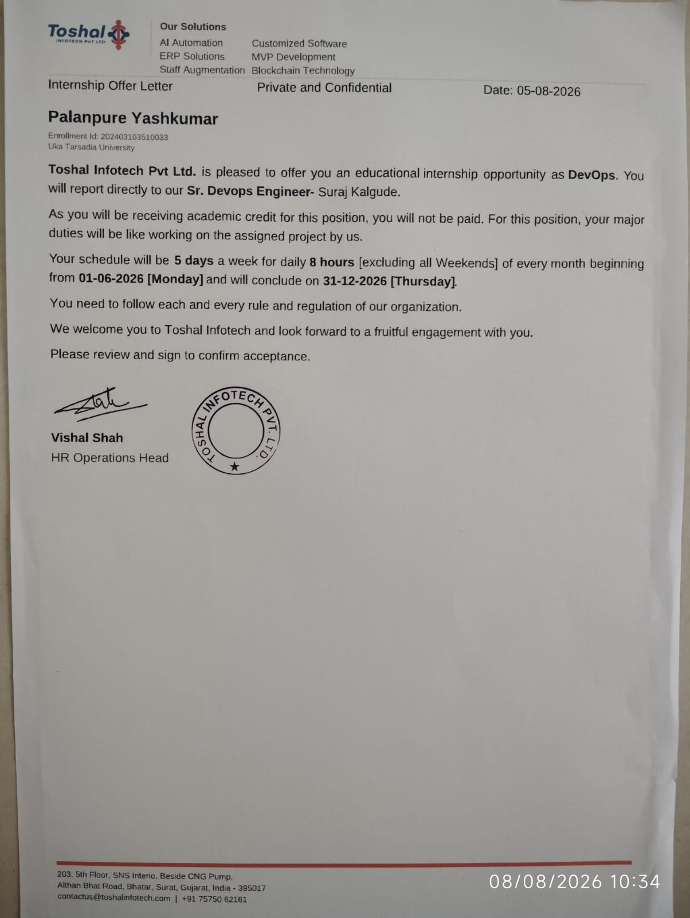
Contract letter: -

Slide 5
Project Introduction
This project is an E-Commerce website developed using Angular. It provides features such as browsing products, viewing product details, managing the shopping cart, and handling user-related data. Product information is fetched using a dummy API, while Browser Local Storage is used to maintain data on the client side. The application is Dockerized and deployed on an AWS EC2 instance to make it available as a live website.

Slide 6
Objective(s)
The main objective of this project is to gain practical experience in modern web development and cloud deployment. It aims to understand how Angular can be used to build a real-world web application, how APIs can be integrated for dynamic data, and how client-side storage can be managed. The project also provides practical knowledge of Docker and AWS EC2 deployment, helping to understand the process of taking an application from development to a live environment.

Slide 7
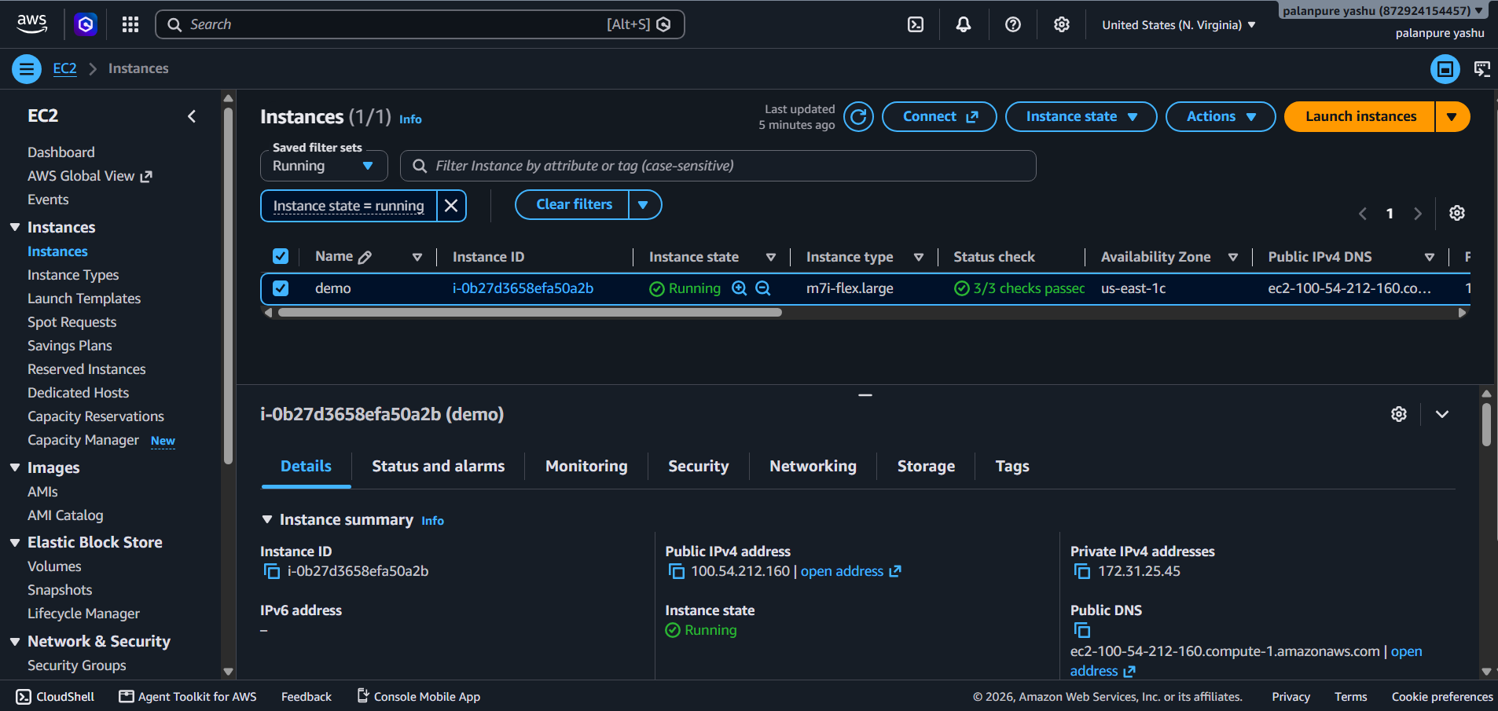

Slide 8
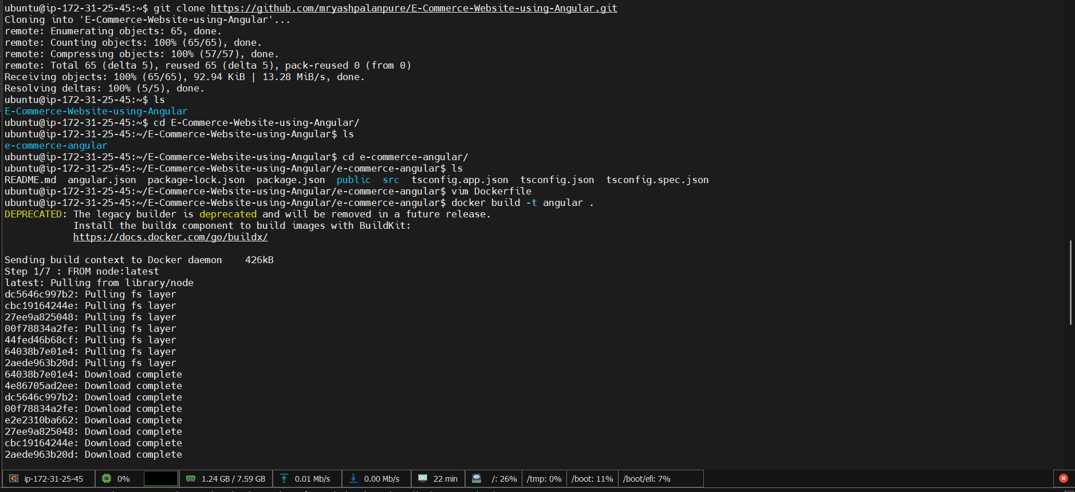

Slide 9
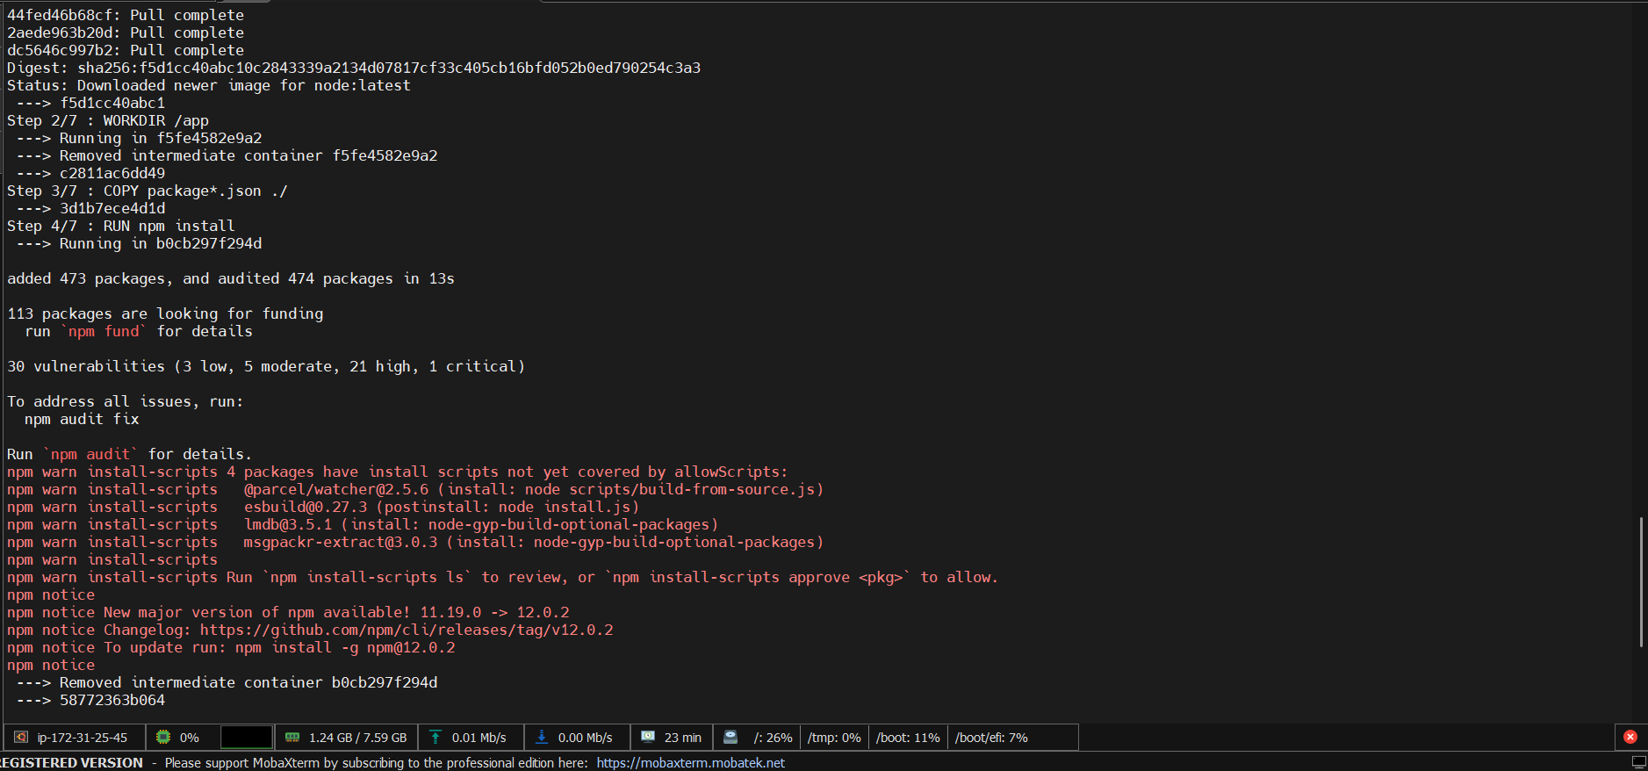

Slide 10
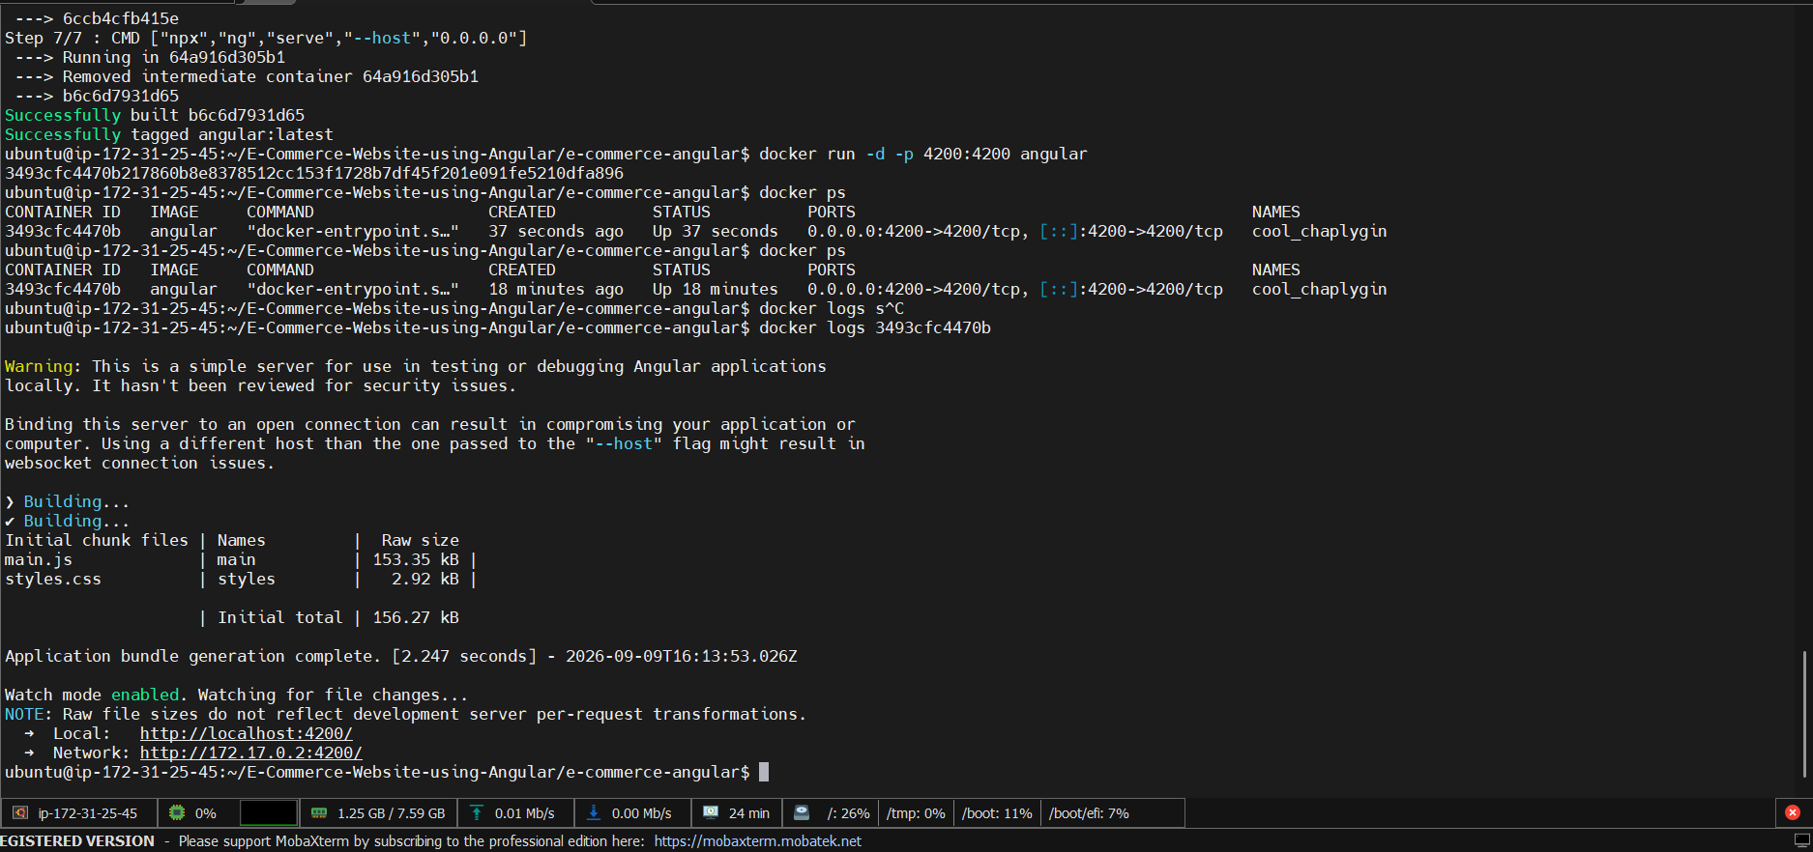

Slide 11
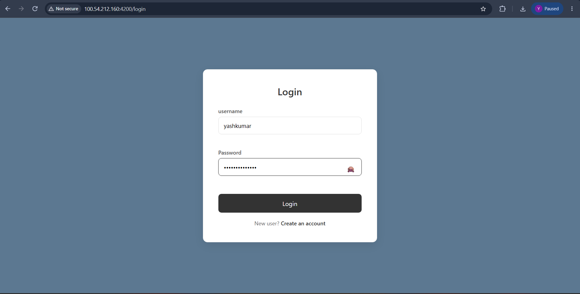

Slide 12
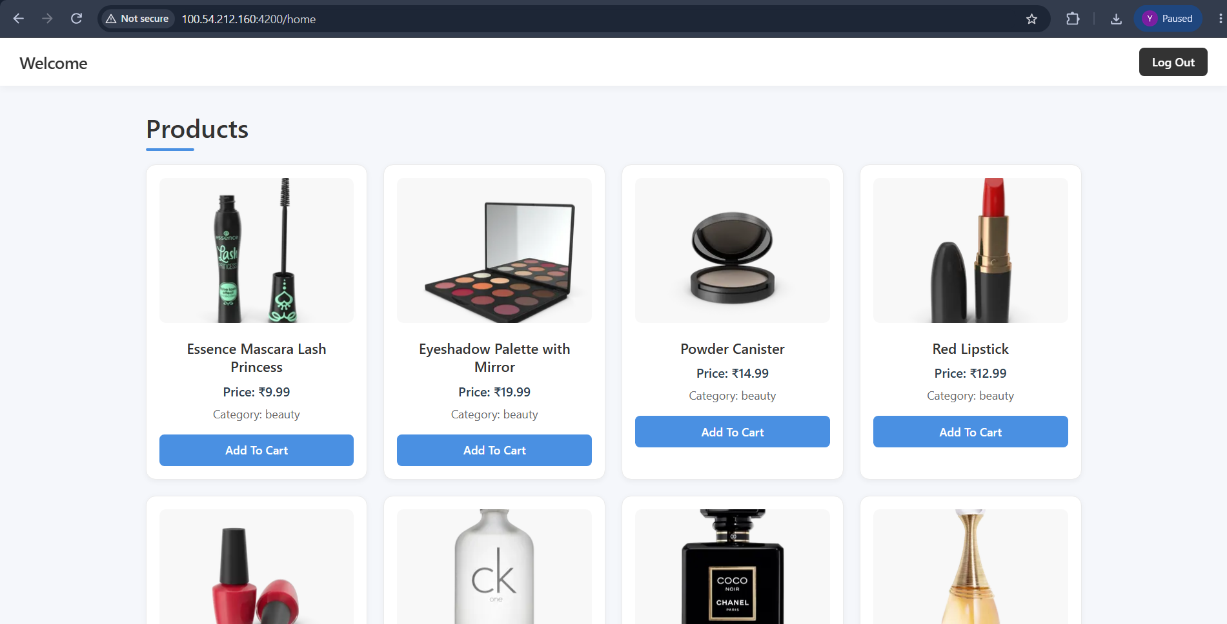

Slide 13
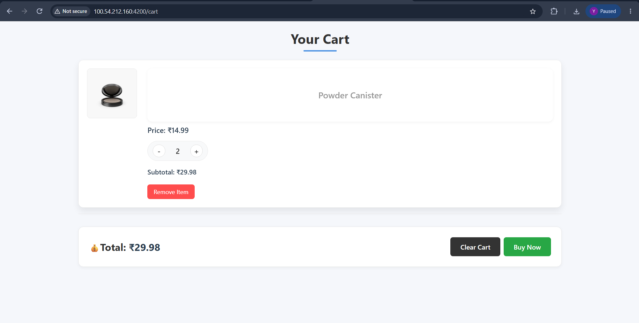

Slide 14
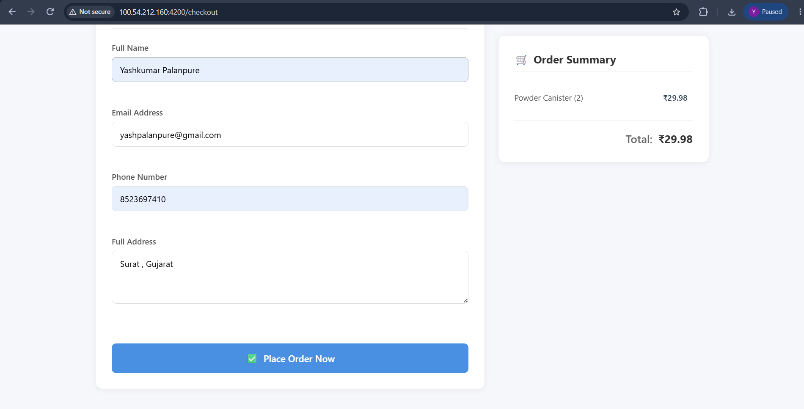

Slide 15
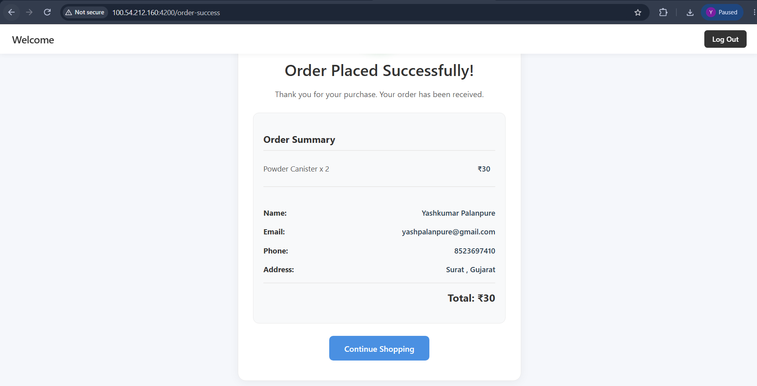

Slide 16
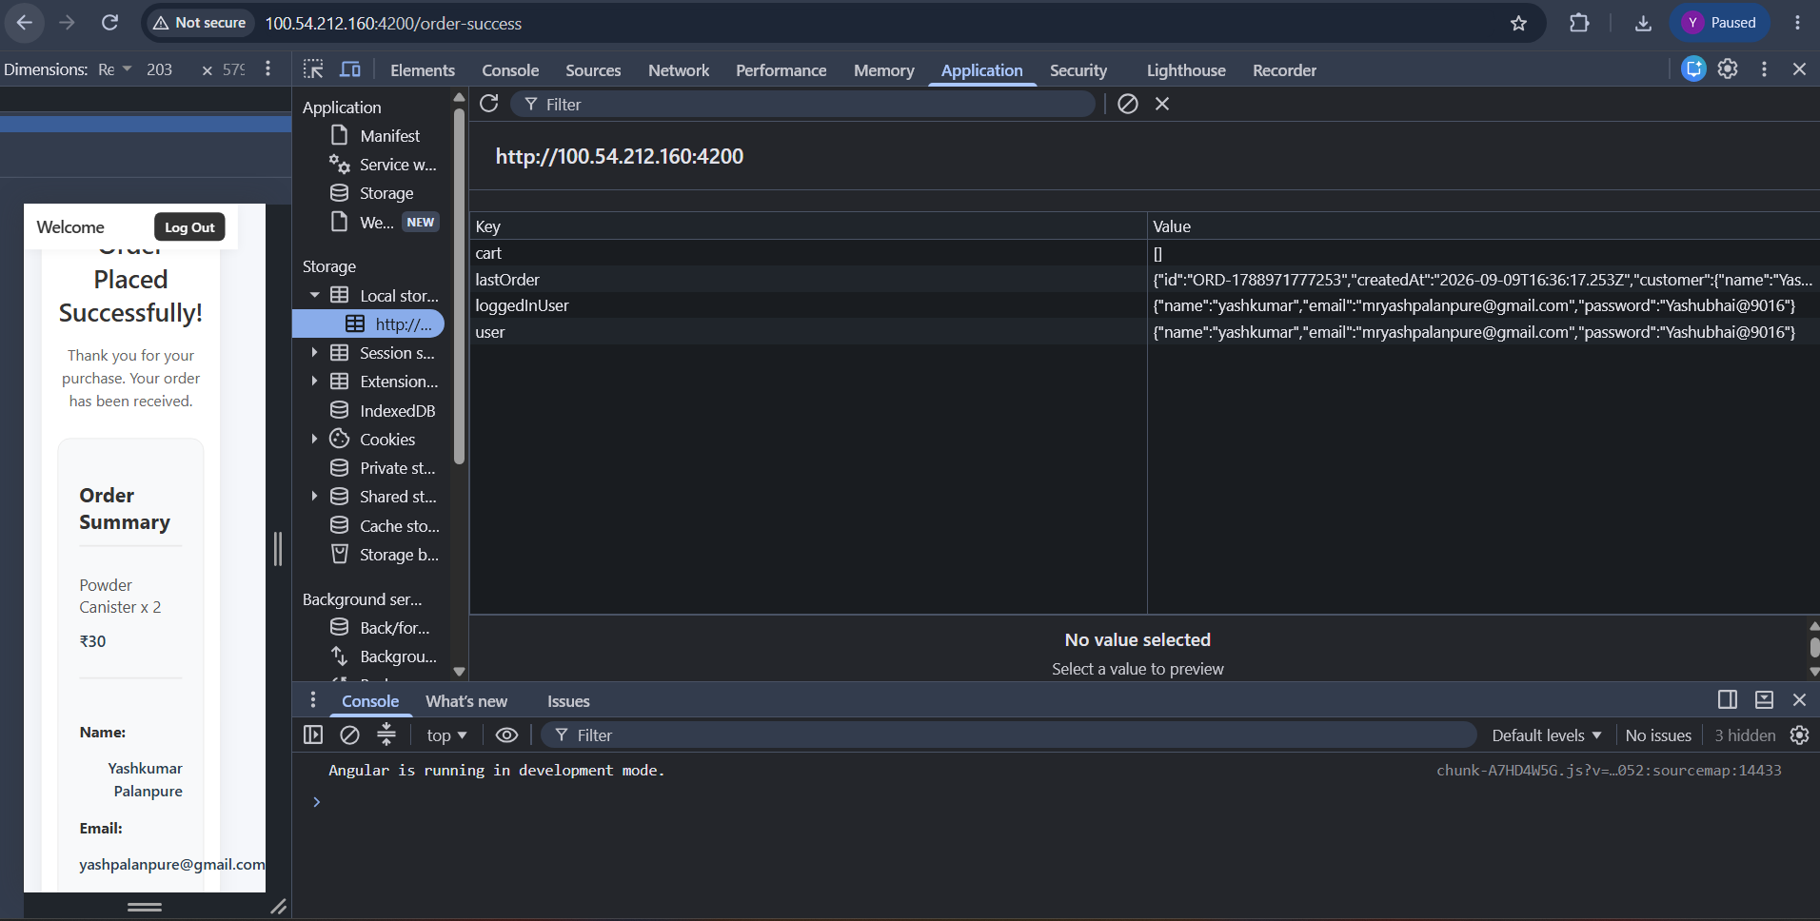

Slide 17
Thank You

